Slide 1
Enhancing Hospital Observation Unit Performance Analysis
Trang Nguyen, Qi Wang

Slide 2

ONTENTS
Problem Description
1
2
Methodology
3
Results
4
Recommendation

Slide 3


Problem Description
identify which patients were more likely to flip from observation to inpatient status.
Background
1
Refine the exclusion list
Identify proper patients for the observation unit to improve hospital Observation Unit operations
Flawed exclusion list High “Flipped” rate
Increased length of stay
Inappropriate utilization of OU capacity
2
Objective
Right Patient, Right bed!

Slide 4
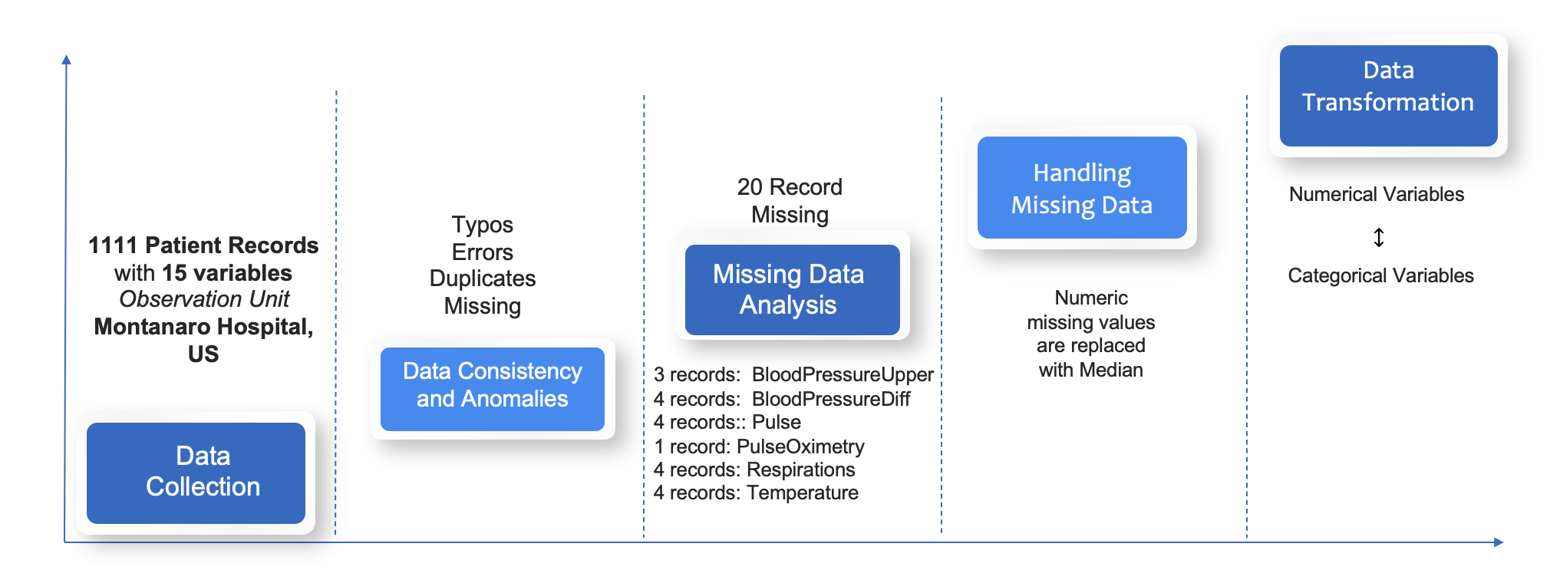
Methodology--Exploratory Data Analysis
Data Collection & Preprocessing

Slide 5
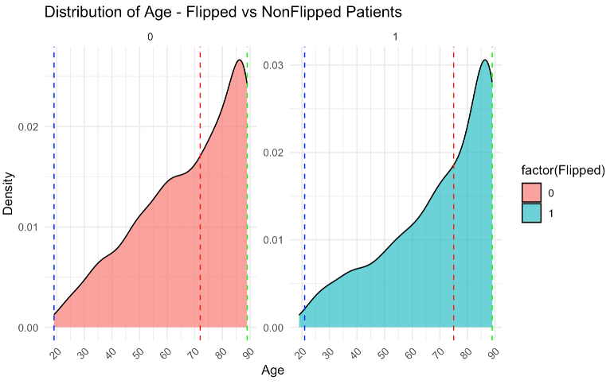
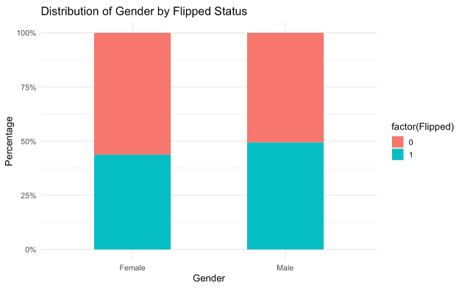
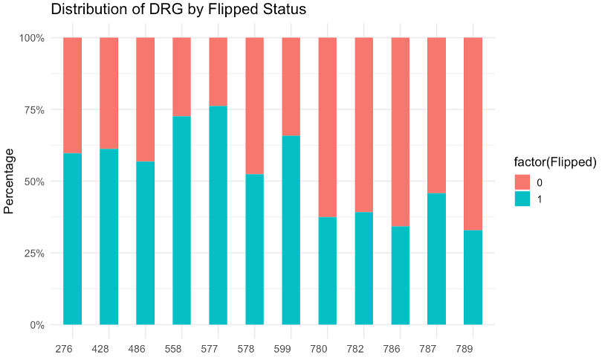
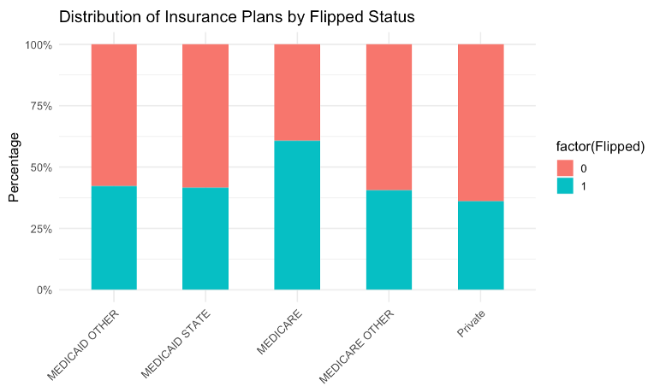
Methodology—Data Descriptions & Visualization Analysis

Slide 6
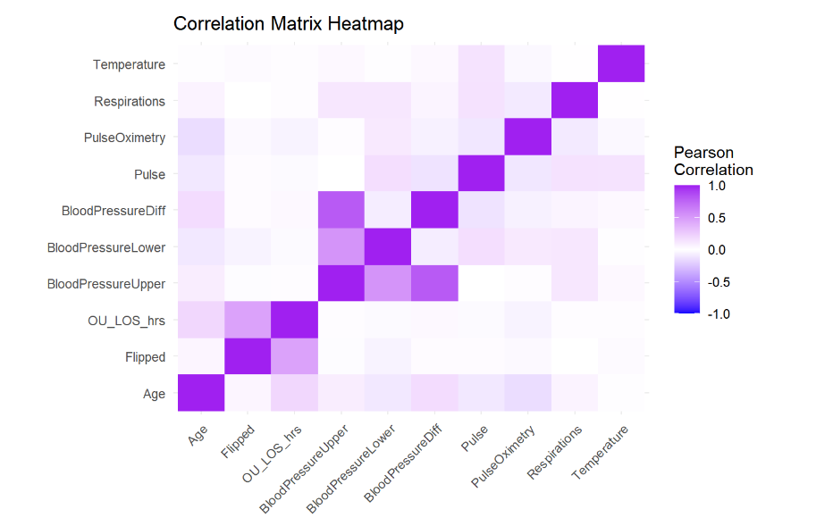
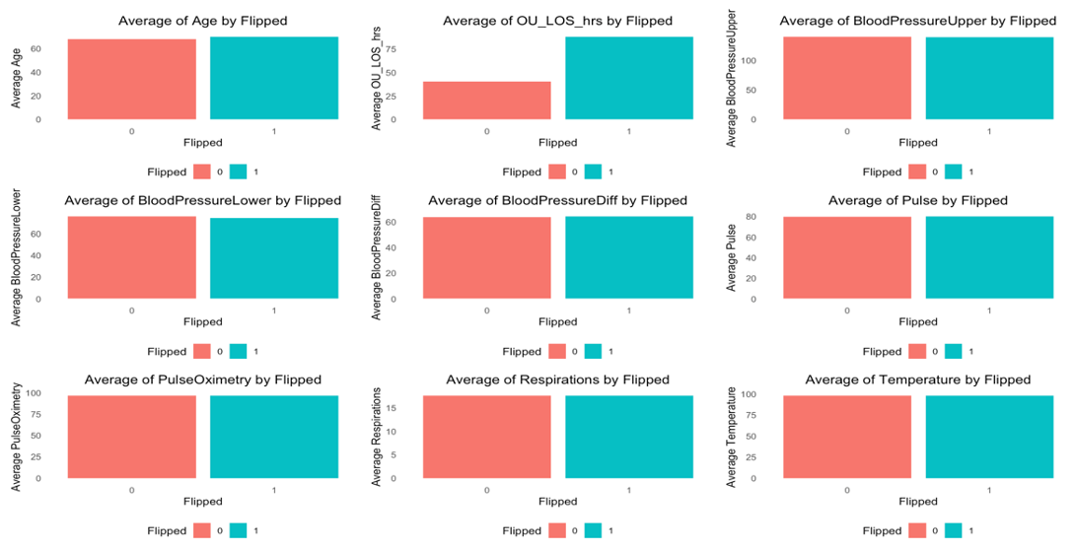
Methodology--Relationship Visualization
Categorical Variables | Correlation Coefficient
DRG01 vs. Flipped | 0.26
Primary Insurance Category vs. Flipped | 0.19
Gender vs. Flipped | 0.054

Slide 7
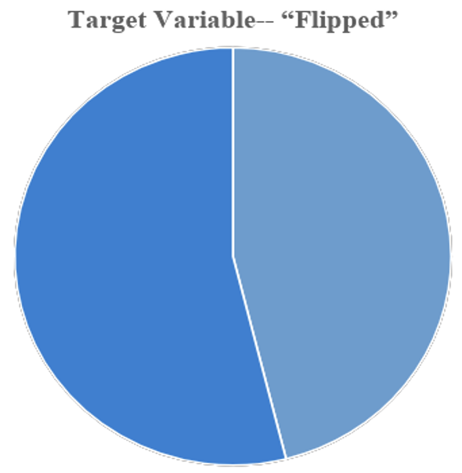
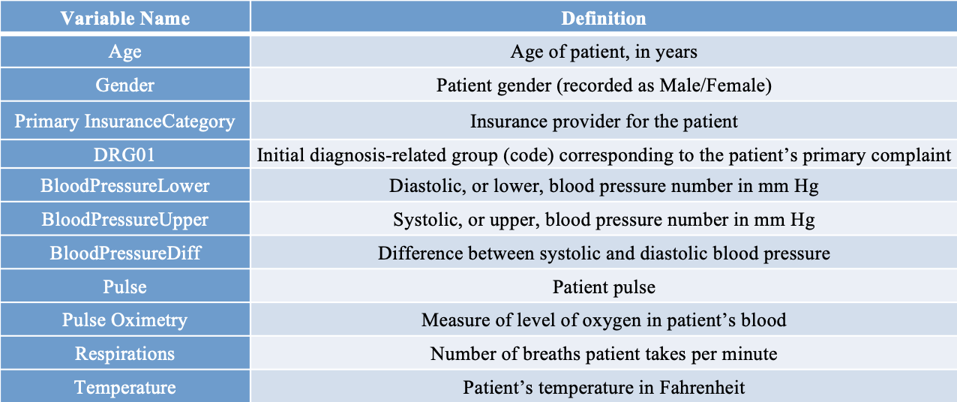
Methodology—Variable Selection
15 variables and 1111 observations in this dataset.
11 Predictors
46.1%
53.9%
Flipped = 0
Flipped = 1

Slide 8
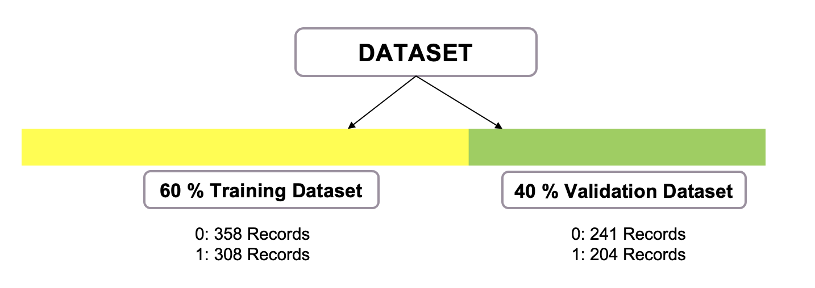
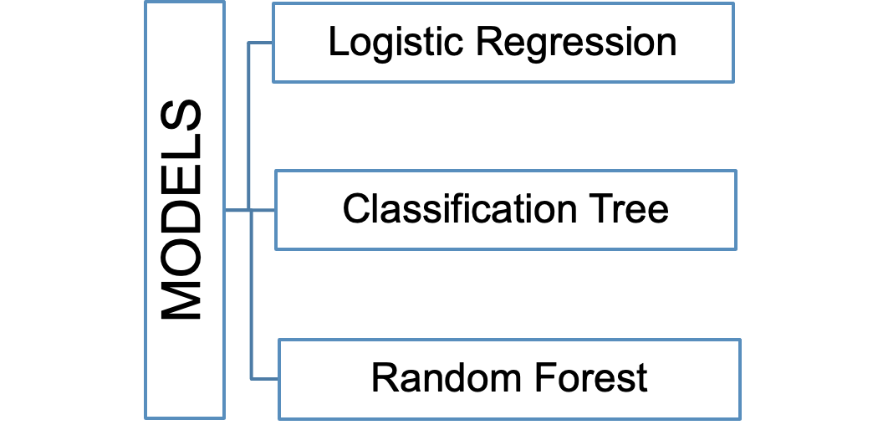
Methodology—Modeling

Slide 9
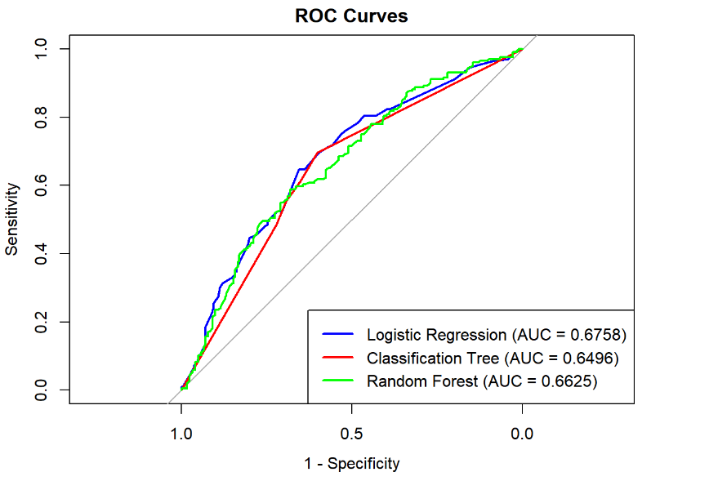
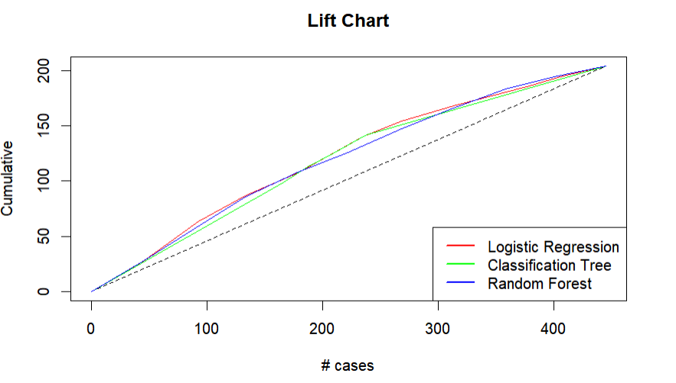
Result—Model comparison
 | Classification Tree | Random Forest | Logistic Regression
Accuracy | 0.6337 | 0.6337 | 0.6292
Sensitivity | 0.6515 | 0.6805 | 0.7178
Specificity | 0.6653 | 0.5784 | 0.5245

Slide 10
Result—OU Performance Comparison
 | Classification Tree | Random Forest | Logistic Regression
Flipped rate | 33.47% | 34.4% | 35.93%
Inpatient mismatch rate | 34.85% | 31.95% | 28.22%
Treated patients per week | 49 | 49 | 48
Average length of stay per patient(h) | 53.64 | 54.02 | 54.64
Flipped rate：45%
Future OU Performance
Treated Patients：44 per week
vs
Flipped rate: About one-third
Average LOS per patient in OU: 58.34 h
Treated Patients: 49 per week
Current OU Performance
Average LOS per patient in OU: 53.64 h

Slide 11
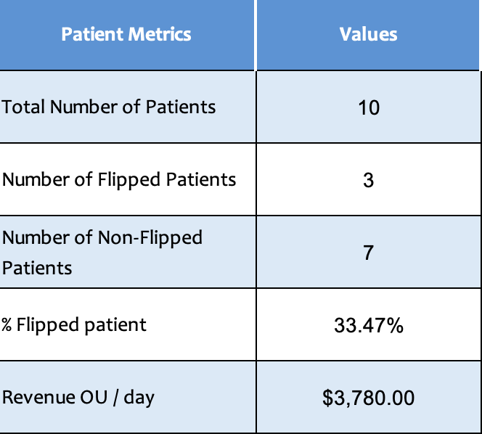
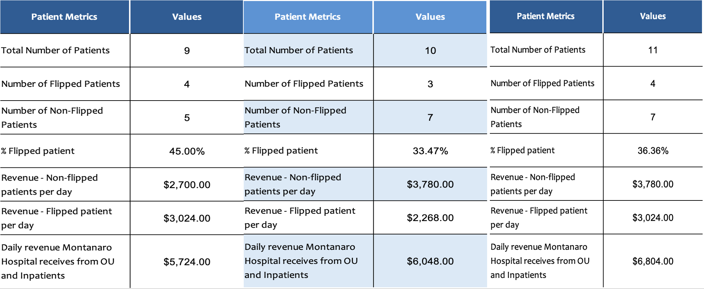
Result—OU Performance Comparison
Current OU Performance
Performance - Recommended Model
Performance - Optimization Model
Revenue OU / day
Revenue OU / day

Slide 12
Recommendation
Additional OU Exclusion Diagnoses List
1. 276 Dehydration
2. 428 Congestive Heart Failure
3. 486 Pneumonia***
4. 558 Colitis
5. 577 Pancreatitis***
6. 578 GI Bleeding***
7. 599 Urinary Tract Infection***

Slide 13
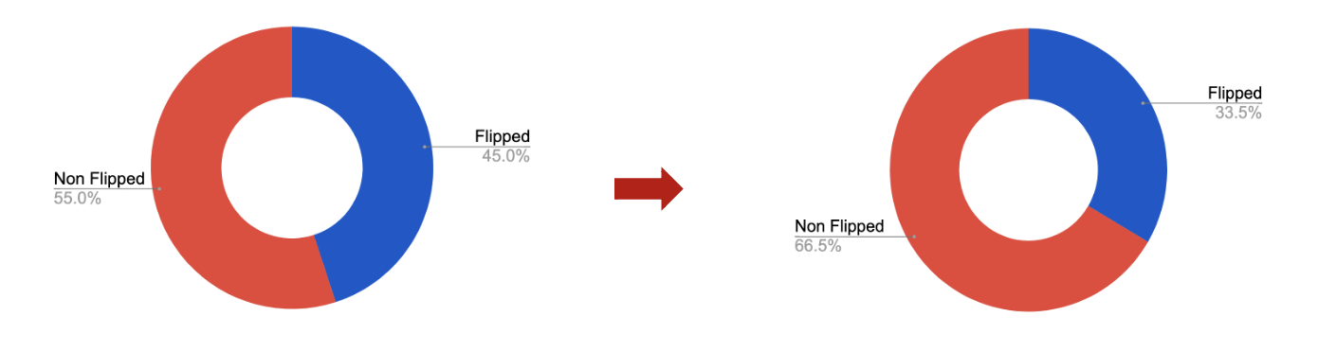
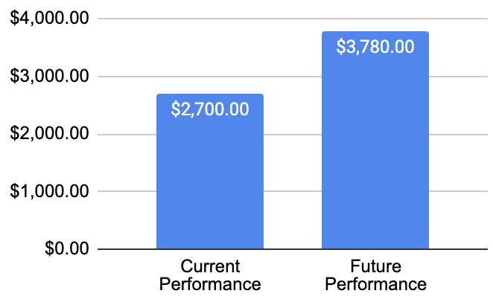
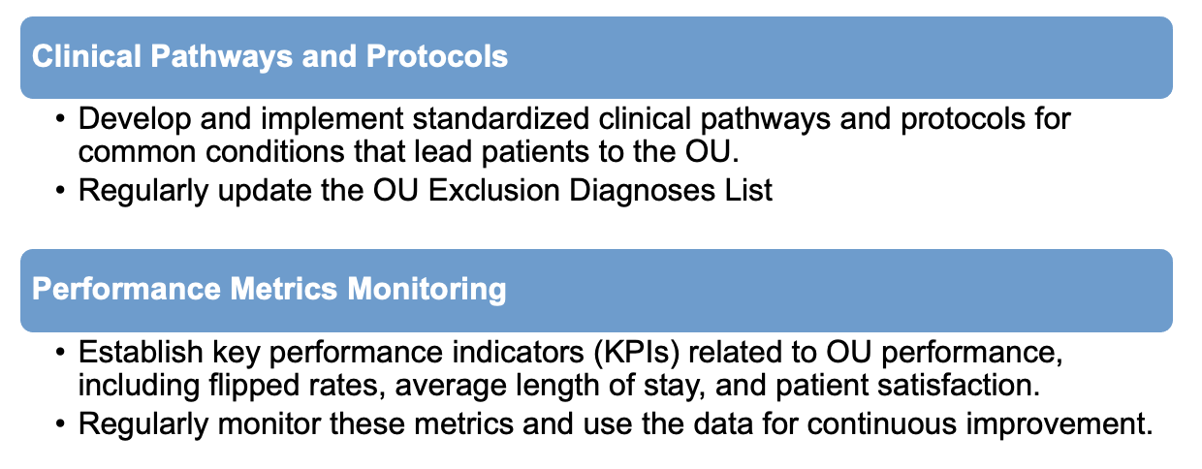
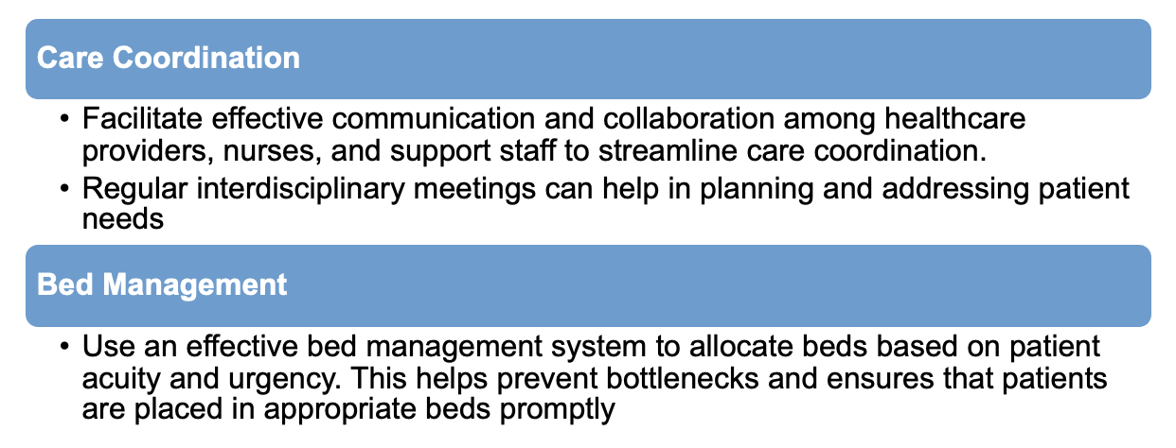
Recommendation
Operation
Maximize Revenue
Future Research

Slide 14
Thank You！

Slide 15
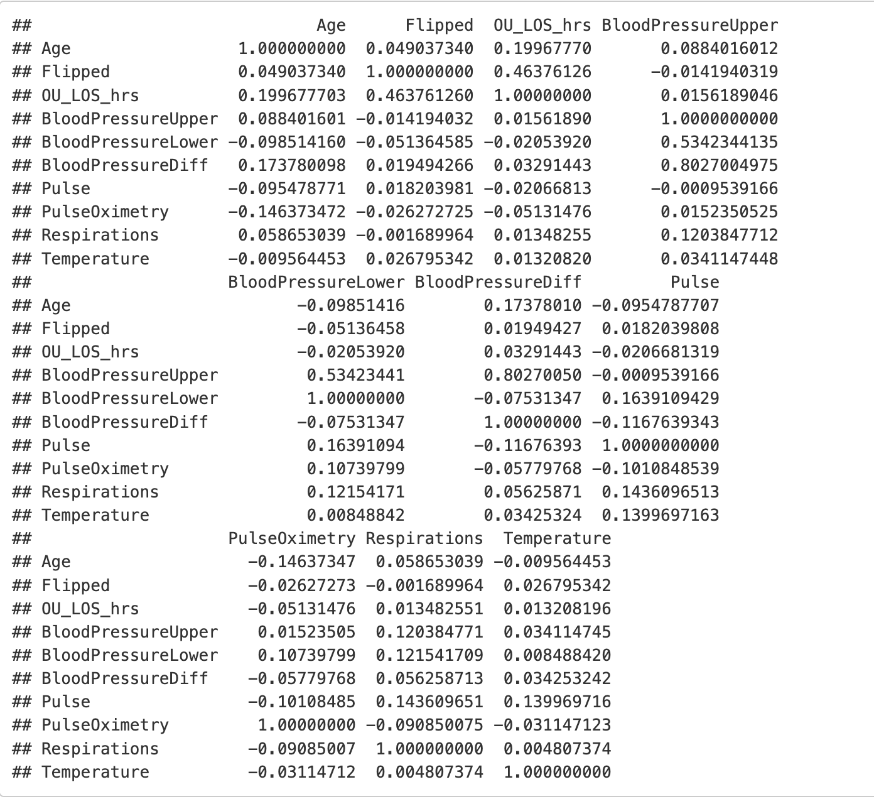
APPENDIX – Correlation Coefficient

Slide 16
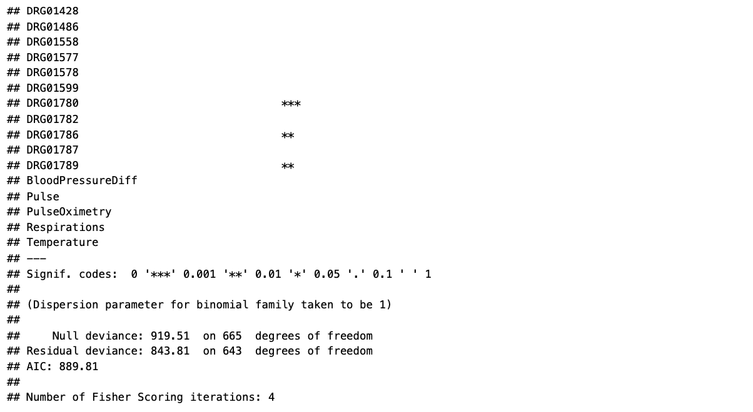
APPENDIX – Logistic Regression

Slide 17
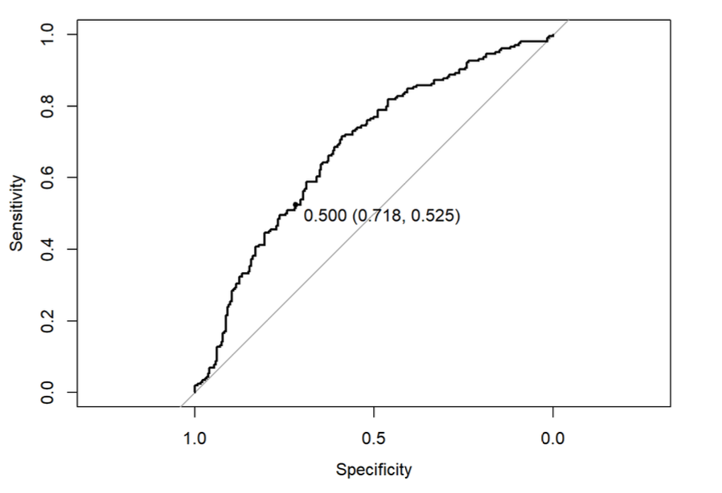
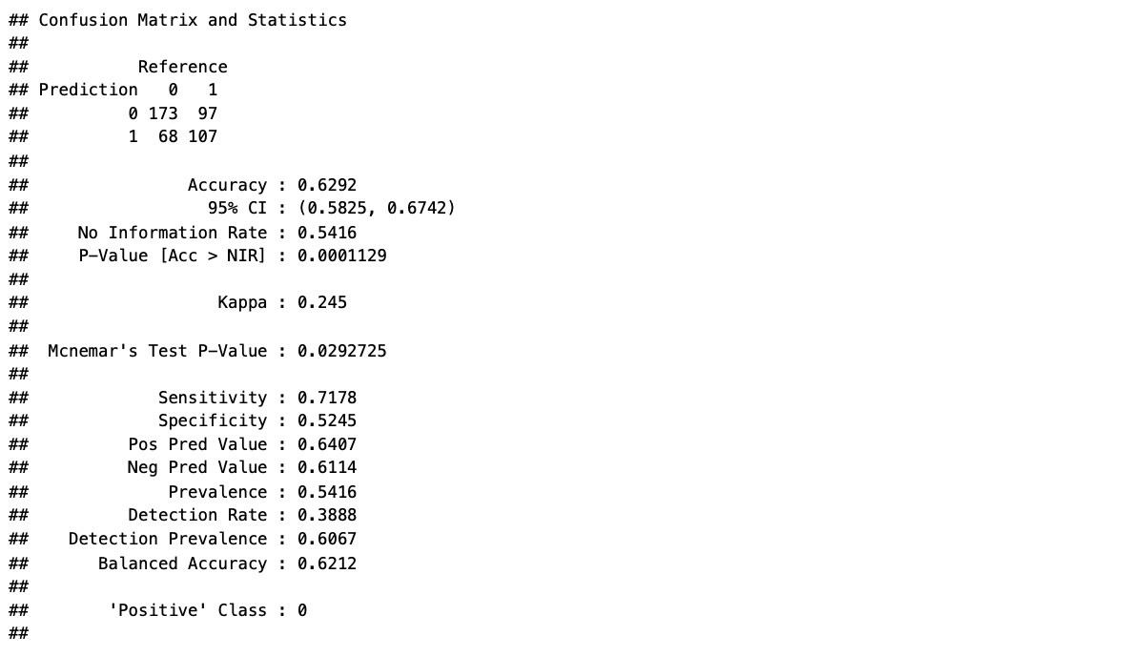
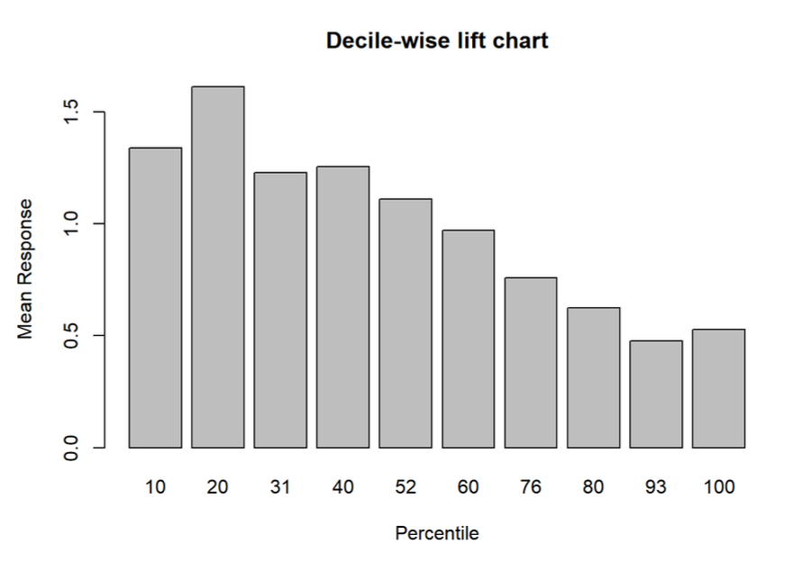
APPENDIX – Logistic Regression

Slide 18
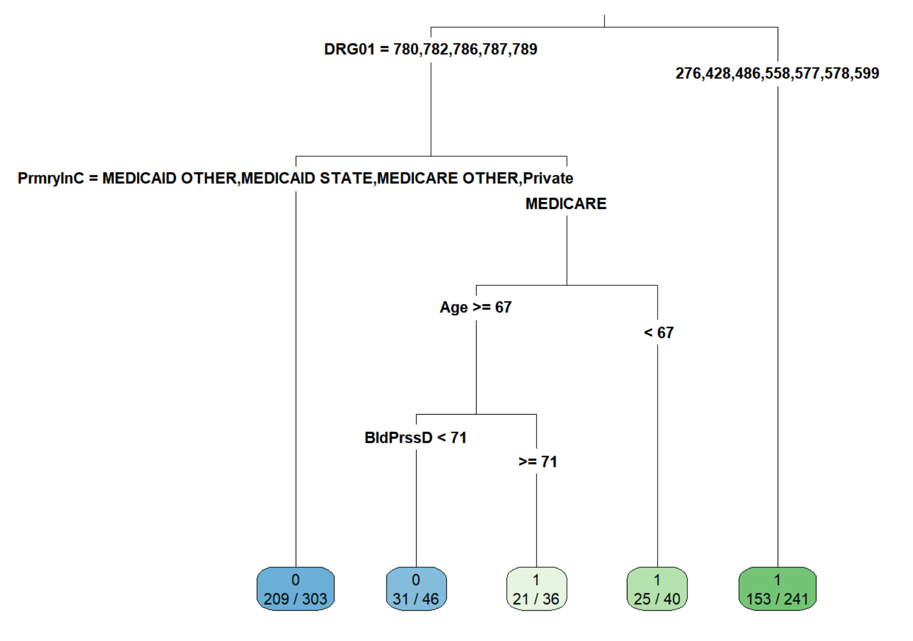
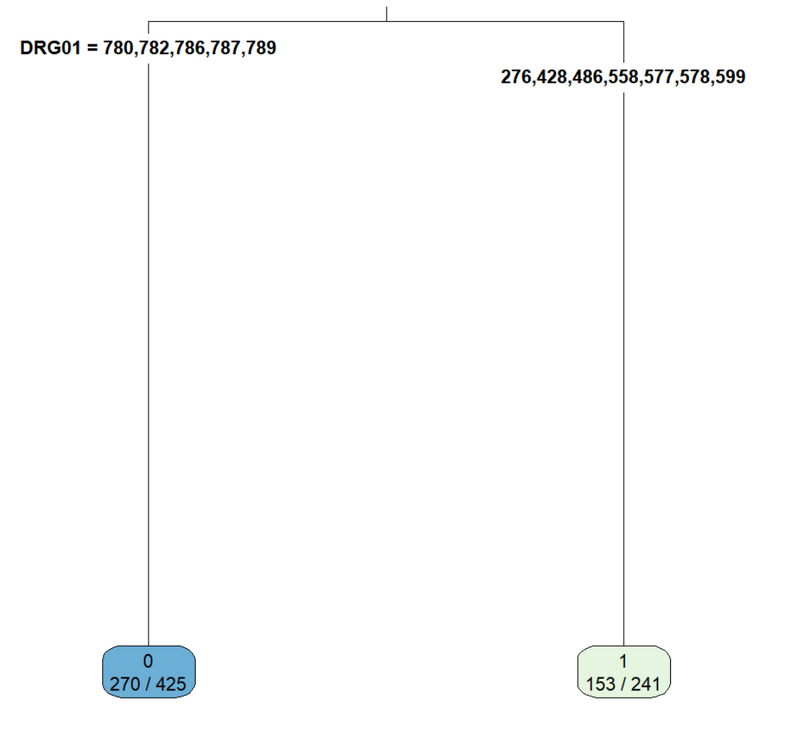
APPENDIX – Classification Tree

Slide 19
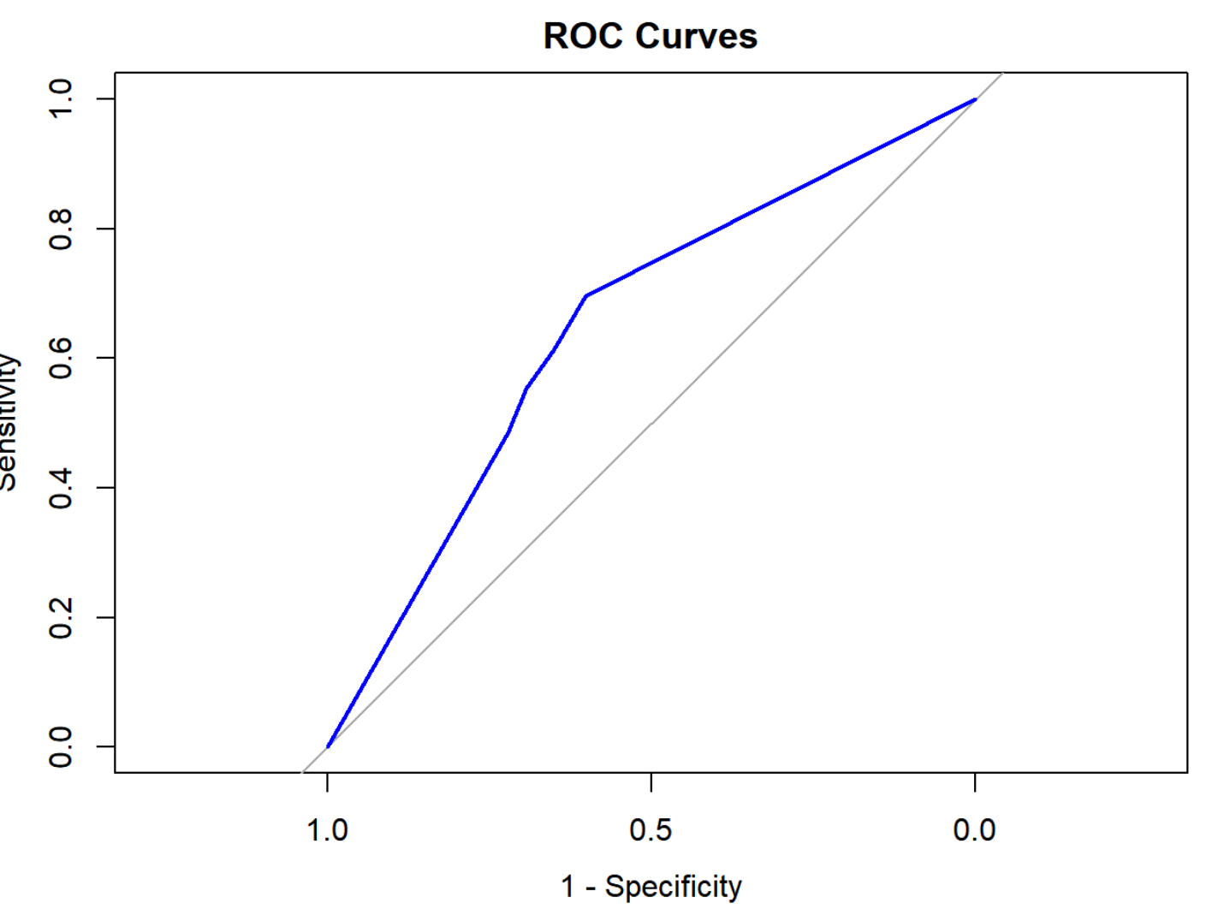
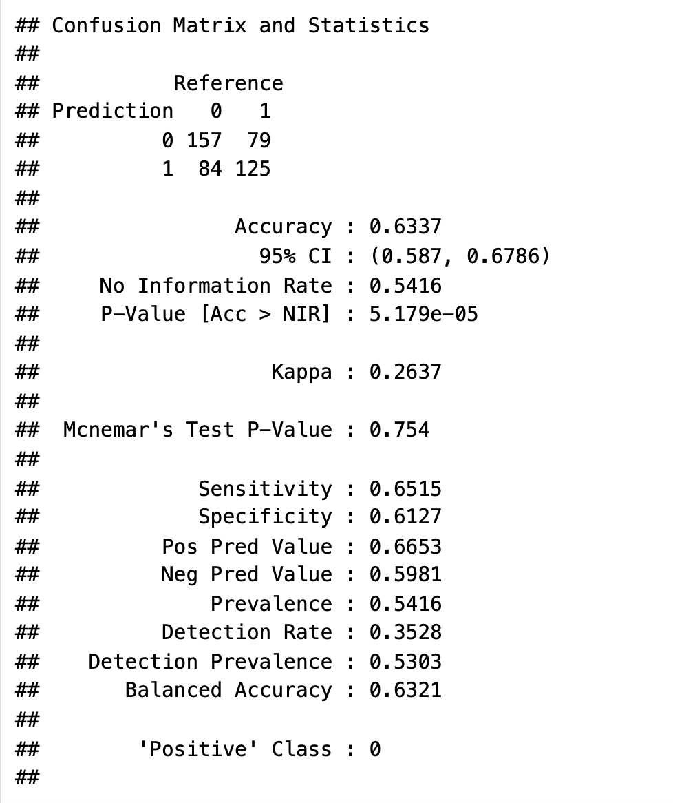
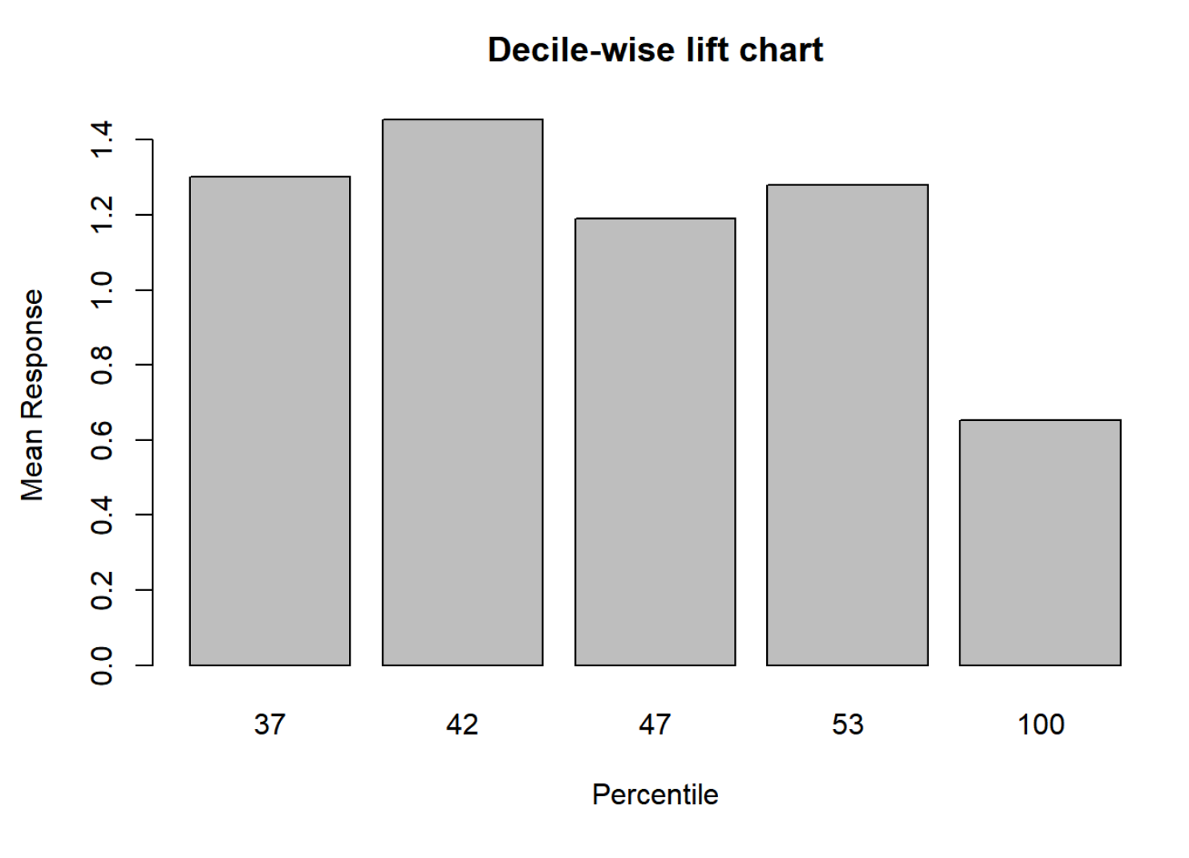
APPENDIX – Classification Tree

Slide 20
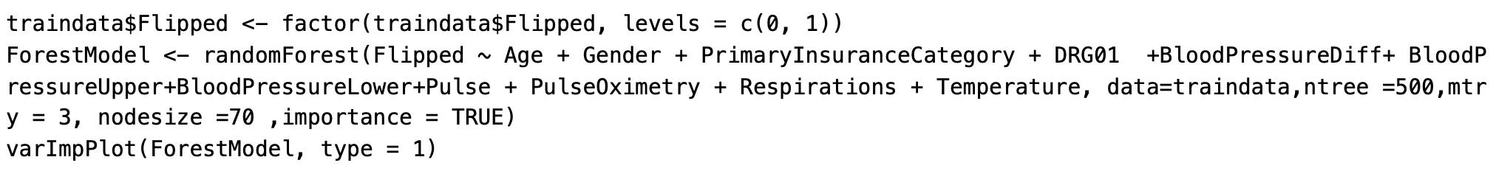
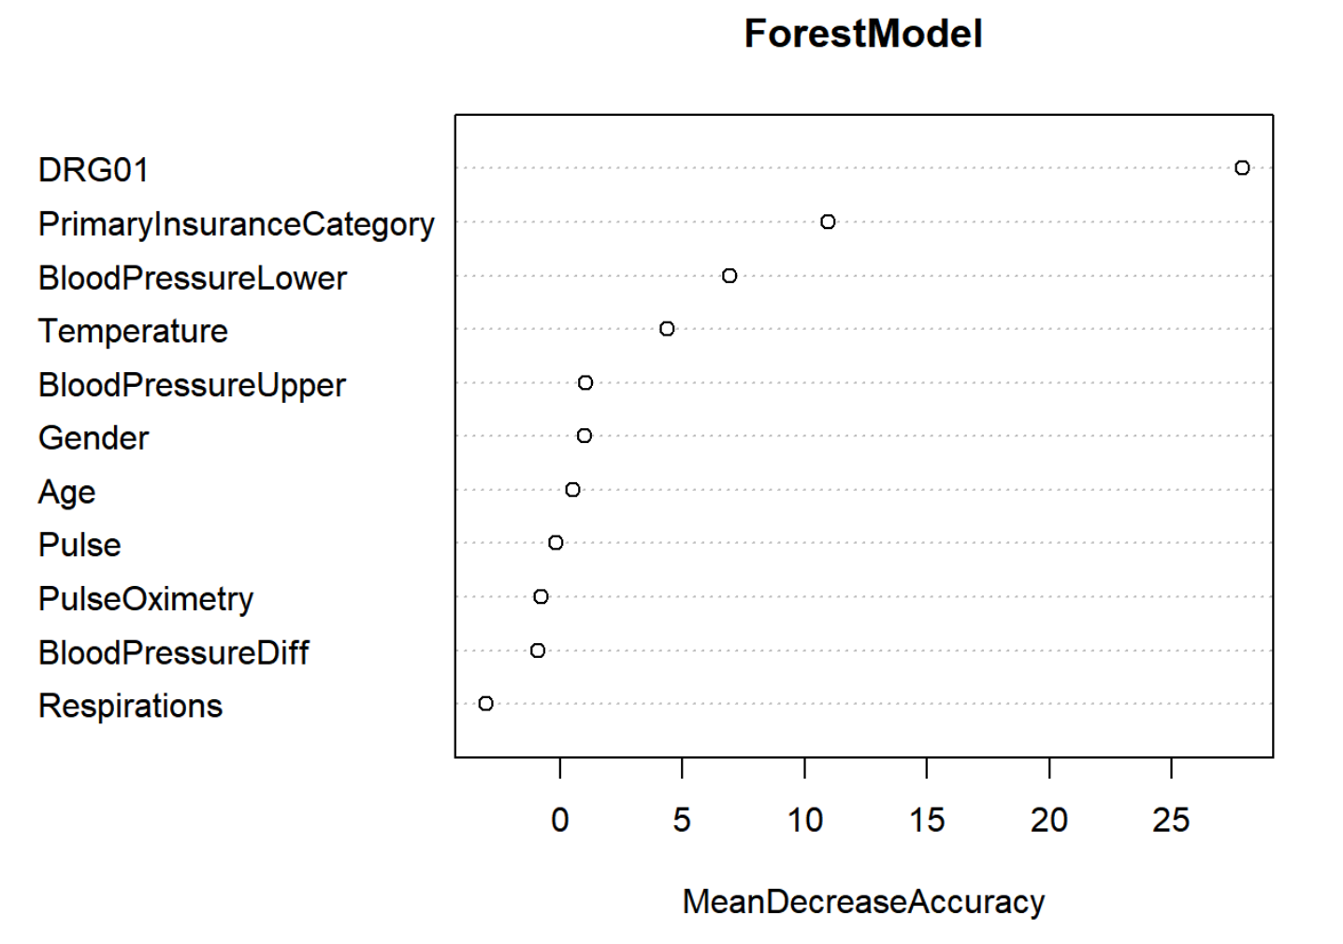
APPENDIX – Random Forest

Slide 21
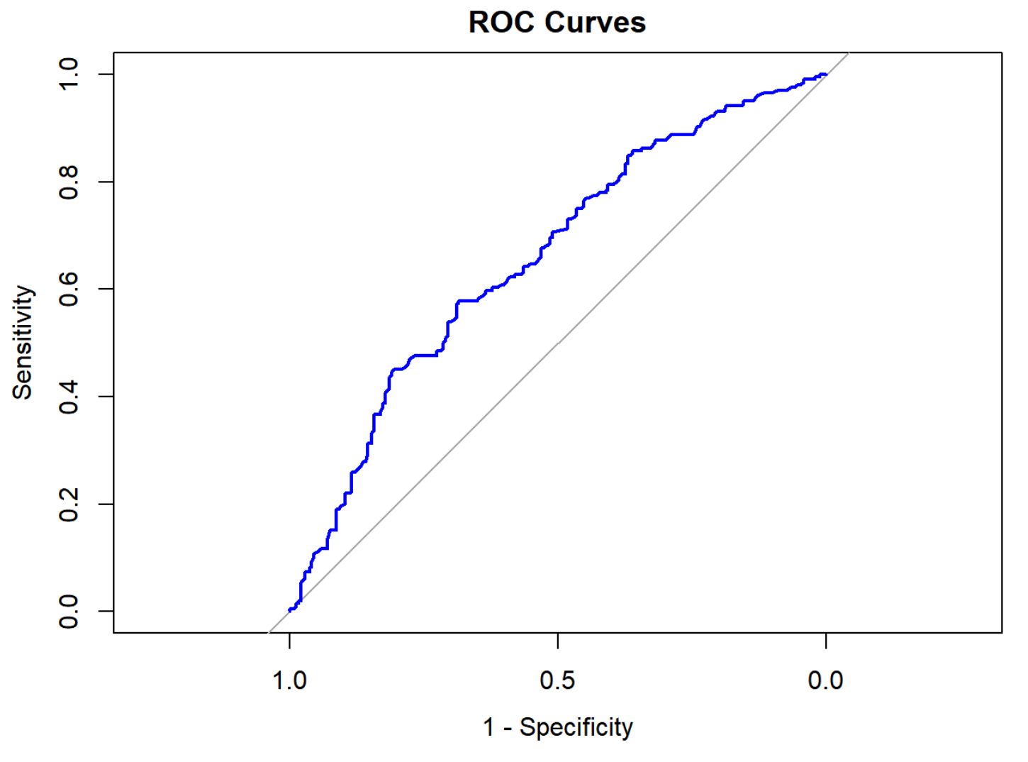
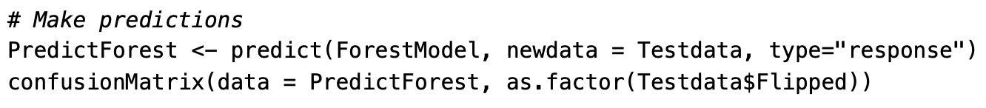
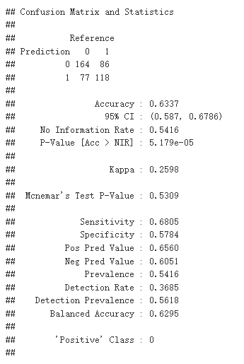
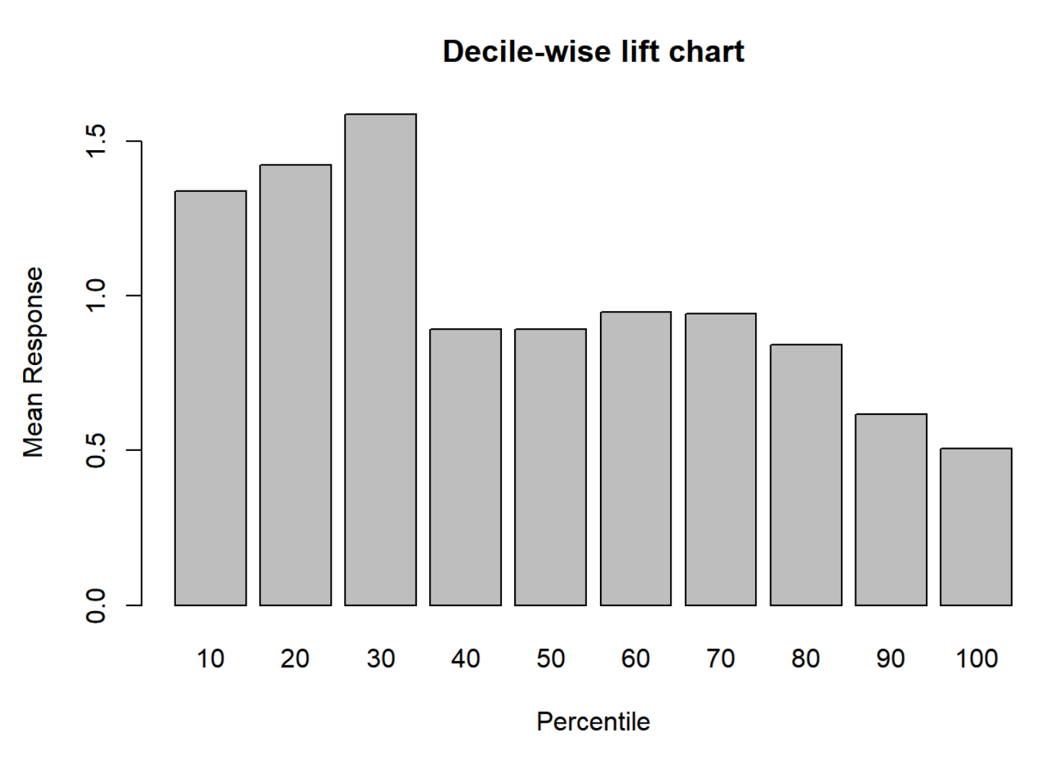
APPENDIX – Random Forest

Slide 22
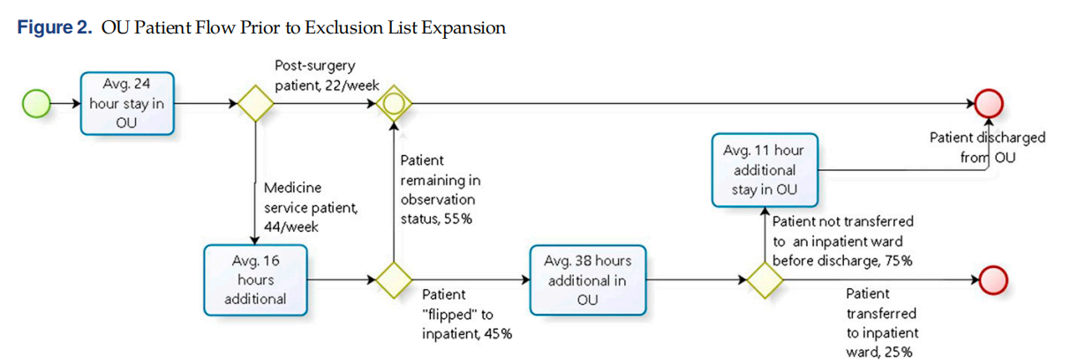
APPENDIX

Slide 23
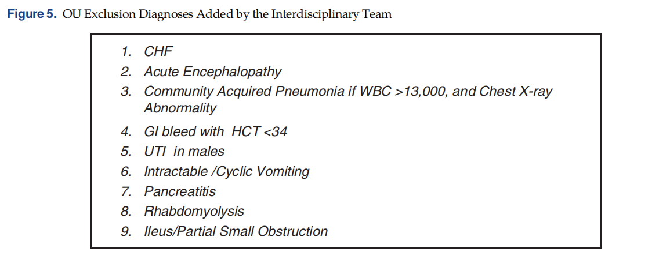
APPENDIX – Additional OU Exclusion Diagnosis List

Slide 24
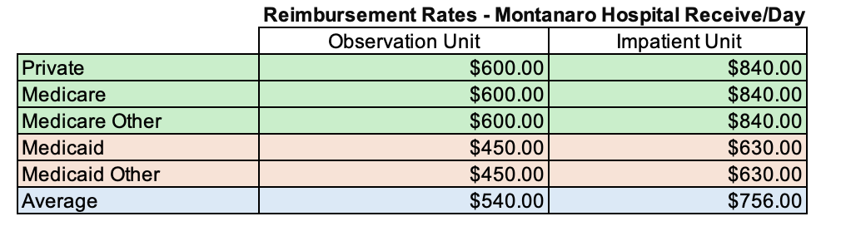
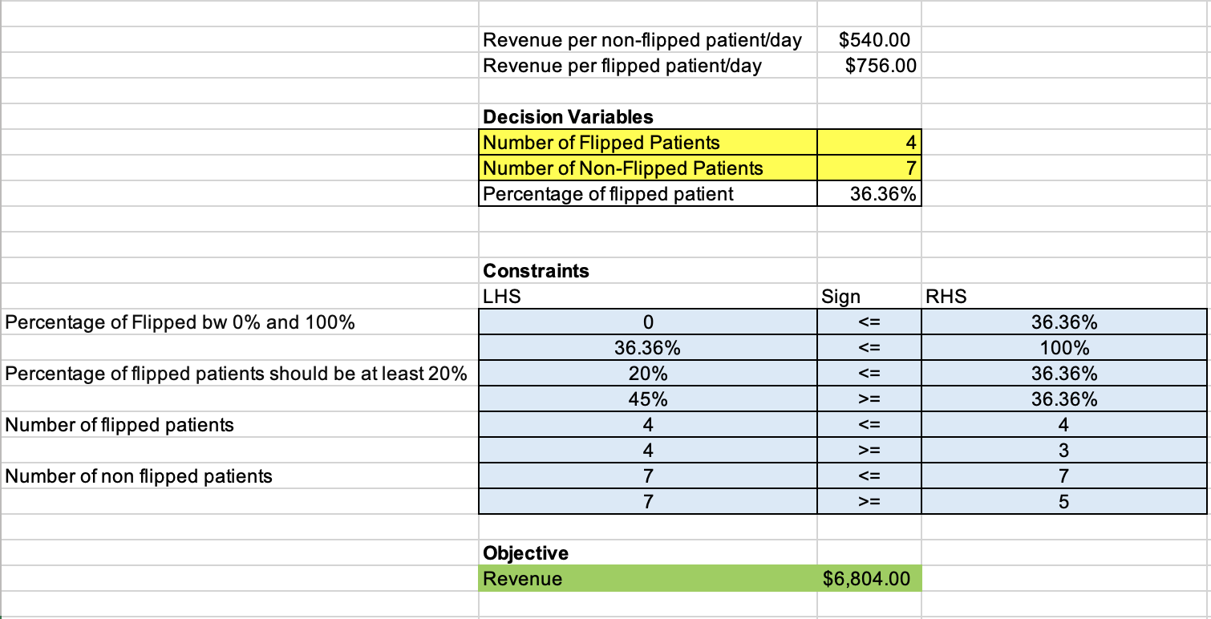
APPENDIX – Optimization Model
Dr. Kelly wants to decrease the percentage of flipped patients from 45% to 20%; so she can treat 55 medicine service patients per week (11 patients / day) in the OU instead of 44 (8 patients / day)

Slide 25
Resources
Dessislava Pachamanova, Vera Tilson, Keely Dwyer-Matzky (2021) Case Article—Machine Learning, Ethics, and Change Management: A Data-Driven Approach to Improving Hospital Observation Unit Operations. INFORMS Transactions on Education 22(3):178-187.
https://doi.org/10.1287/ited.2021.0251ca

